Slide 1
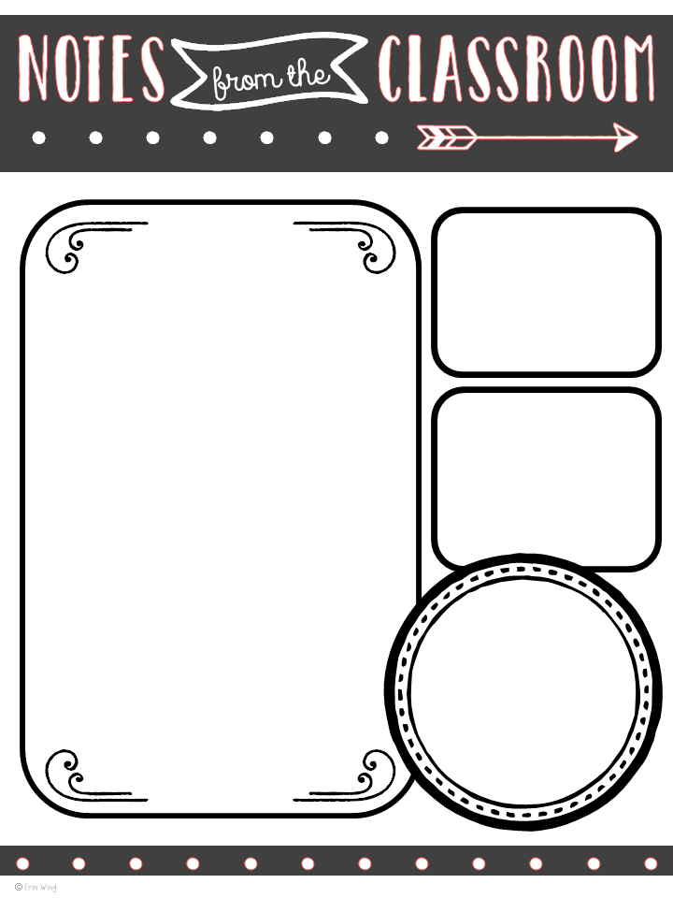
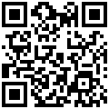
Coaching Connections
Vol. 7
www.coachcann.weebly.com
December 10, 2015
Reflect & Renew
Good
Reads
How Teachers Can Manage Stress and Build Resilience
Click on the Link or
Scan the QR Code
Whew! We have wrapped up the first trimester, report cards are done, conferences are over and winter break is almost here! (YAY!) Take a moment to reflect on all that you have accomplished with your class and your colleagues. In just over 12 weeks, you have created a strong community of learners focused on being respectful, productive and motivated students. That is quite the accomplishment!
As we head into the new year, take time for reflection on your classroom and instructional practices. Celebrate what you’ve accomplished and feel is going well. Thihk about the parts of your day you’d like to change or improve. Below are some key questions to help you reflect on what’s happening in your classroom in order to steer you in the right direction for the rest of the year! If you find that there are some practices you’d like to change up, revisit or new risks you’d like to take, the return from Winter Break is the perfect time to make those adjustments. Taking the time to reflect will give you the opportunity to plan and prepare for your changes and also help you remember the great things you’ve got going on in your room each day!
What practices in your room are successful or make you proud? Why?
If you were to pick one part of your day to change or improve on, which would you pick? What would you change?
What part of your day are your students most engaged? Why?
What role does student choice play in your classroom?
Do your assessments report student learning or student accountability? How valuable is the information you receive?
Does your instruction match your beliefs about how students learn best?
What new ideas have you tried in your classroom to keep yourself energized about teaching?
What is one change you could make to your daily routine to relieve stress or make your job easier?
What is the most valuable thing you’ve learned so far this year?
As always, please reach out to me with any ideas you’d like to try together,
support you may need or for further discussion on any of these topics!
☺ Ashley
Try It Out…
Use Interactive Number Lines to Build Number Sense!
Number Sense has been a hot topic all year…here some quick strategies to try with your class today! I’d love to come and try it with your class…let’s pick a date!
Ideas Here
How To Here
App-solutely
Amazing Apps!
EduCreations
Teachers can use this app to create video lessons for their students to use at home, in centers or in the L.A.B.! It’s quick, easy and students are fully engaged!
More Info Here!
Video Here!
Teaching is tough,
but so are you!

